Slide 1
Is Climate Change Real?
Unveiling the Evidence, Causes and Solutions through Data Visualization
Group Members: Ayush Manojkumar Lodha and Harishankar Sekhar
Instructor: Professor Shiaofen Fang TA: Ziqian Bi

Slide 2
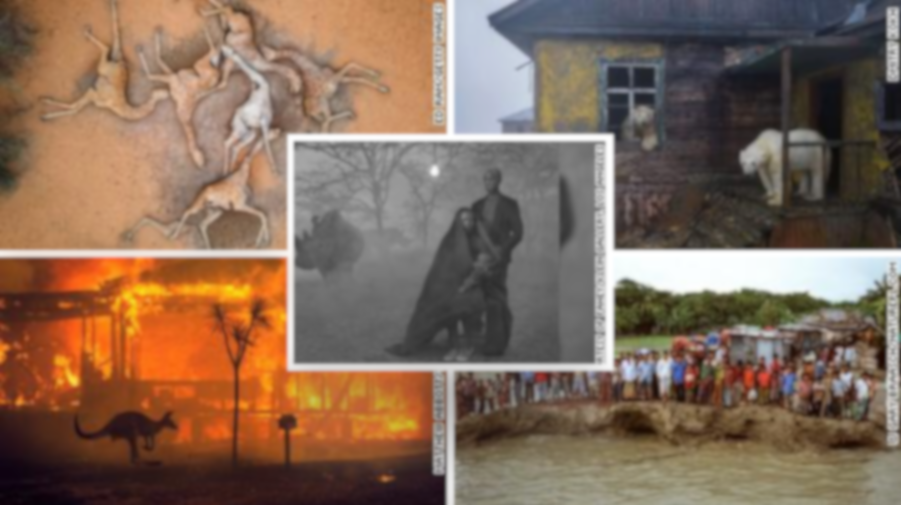
Chapter 1:
Climate Change:
A Myth?

Slide 3



Arguments from non-believers
Some Countries are naturally hot because of their positioning on the the globe.
Some months are naturally hotter than the others. It’s natural

Slide 4
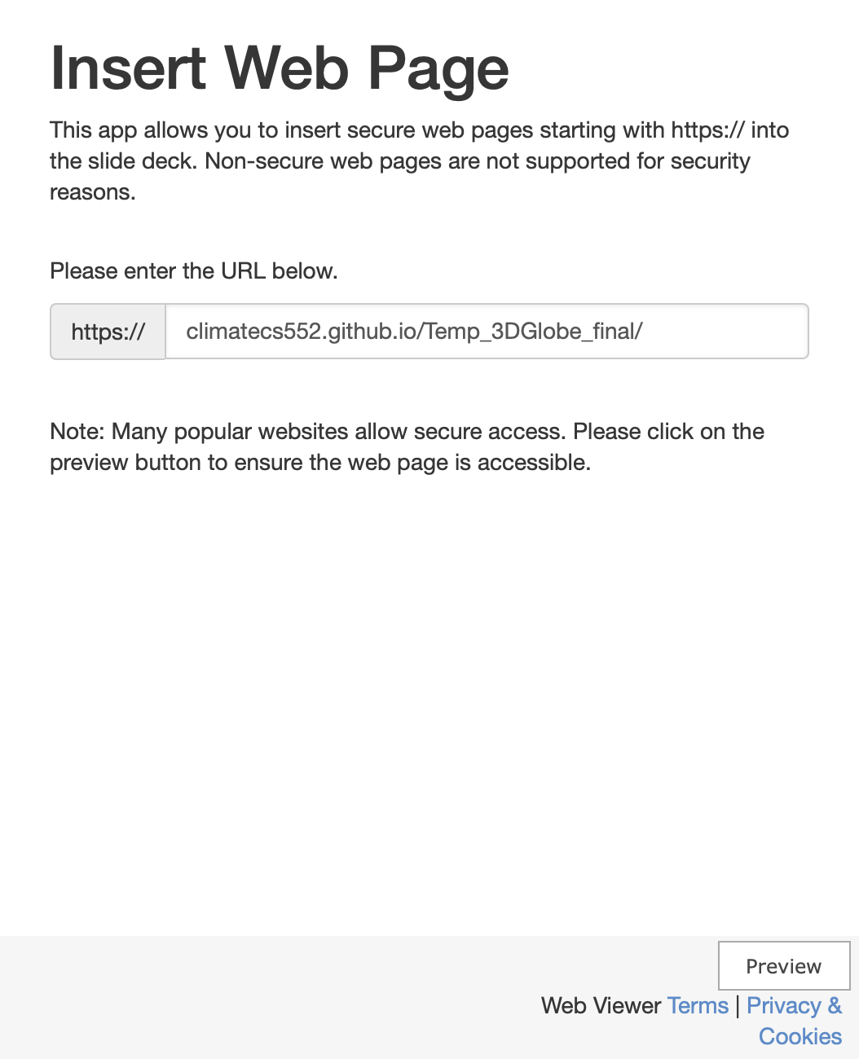
Average Temperature of Countries from last 100 years
Inferences:
Countries that are nearer to the equator experience higher temperatures than the countries near the pole.
Legend from -50 to 50 degrees, shows the transition from a cold region(dark blue) to 0 degree (white) to rising hot temperature(dark red).
This visualization has the dropdown menu and we can select the country which we want to look into. (It will take us there)

Slide 5


Slide 6
Let’s Merge above two ideas and run a spatio-temporal time series
Click Here

Slide 7

Radial Chart of Global Temperature Anomaly
Inferences:
This radial chart clearly shows how we have increased the temperatures of the planet after the industrial revolution in the 1850s
The post shared by NASA inspired the idea.

Slide 8
Chapter 2:
Consequences

Slide 9
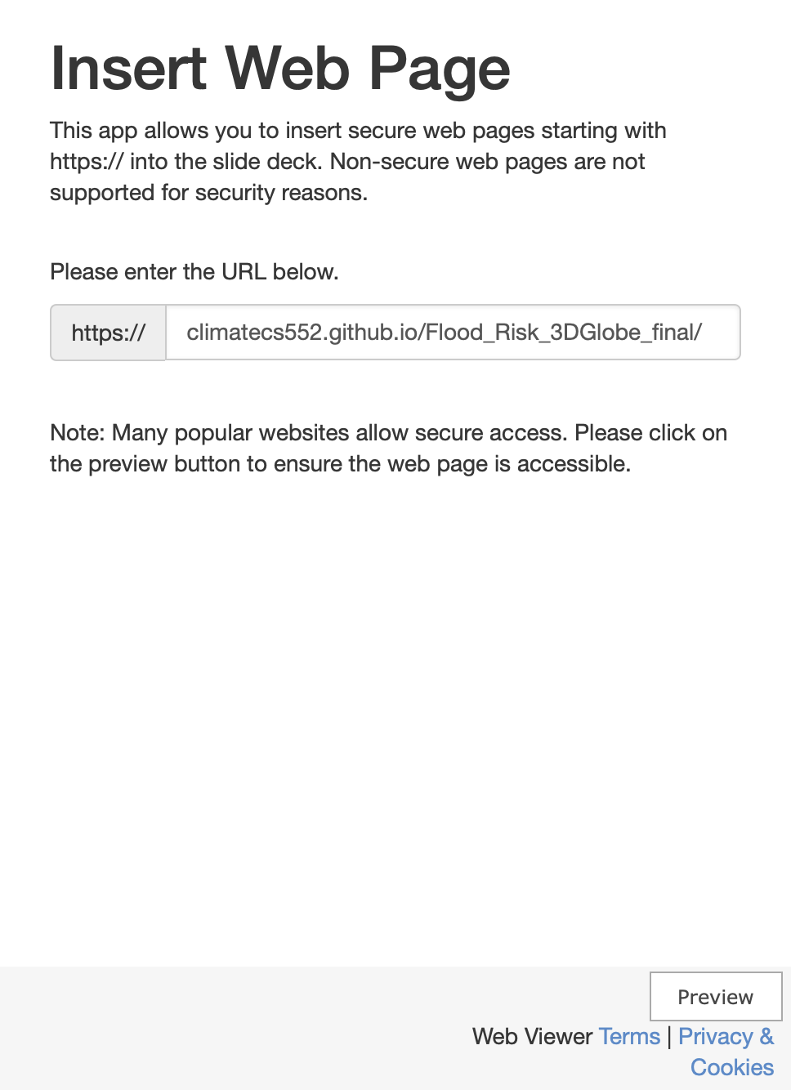
Flood Risk of different countries
Rise in Temperature
🌡️
Melting of Snow
❄️
Sea Level to Rise
🌊
Risk of flood Increases
😔

Slide 10

Climate Risk of different countries
Global Climate Risk Index identifies the extent to which countries have been affected by extreme weather events
Inferences:
The lower the value of this score (towards 0), the higher the risk [darker the color in the globe]
Asian and African Countries
Higher the value of this score(towards 200), lower the risk [lighter color]
European and North American Countries

Slide 11
Chapter 3:
Cause

Slide 12
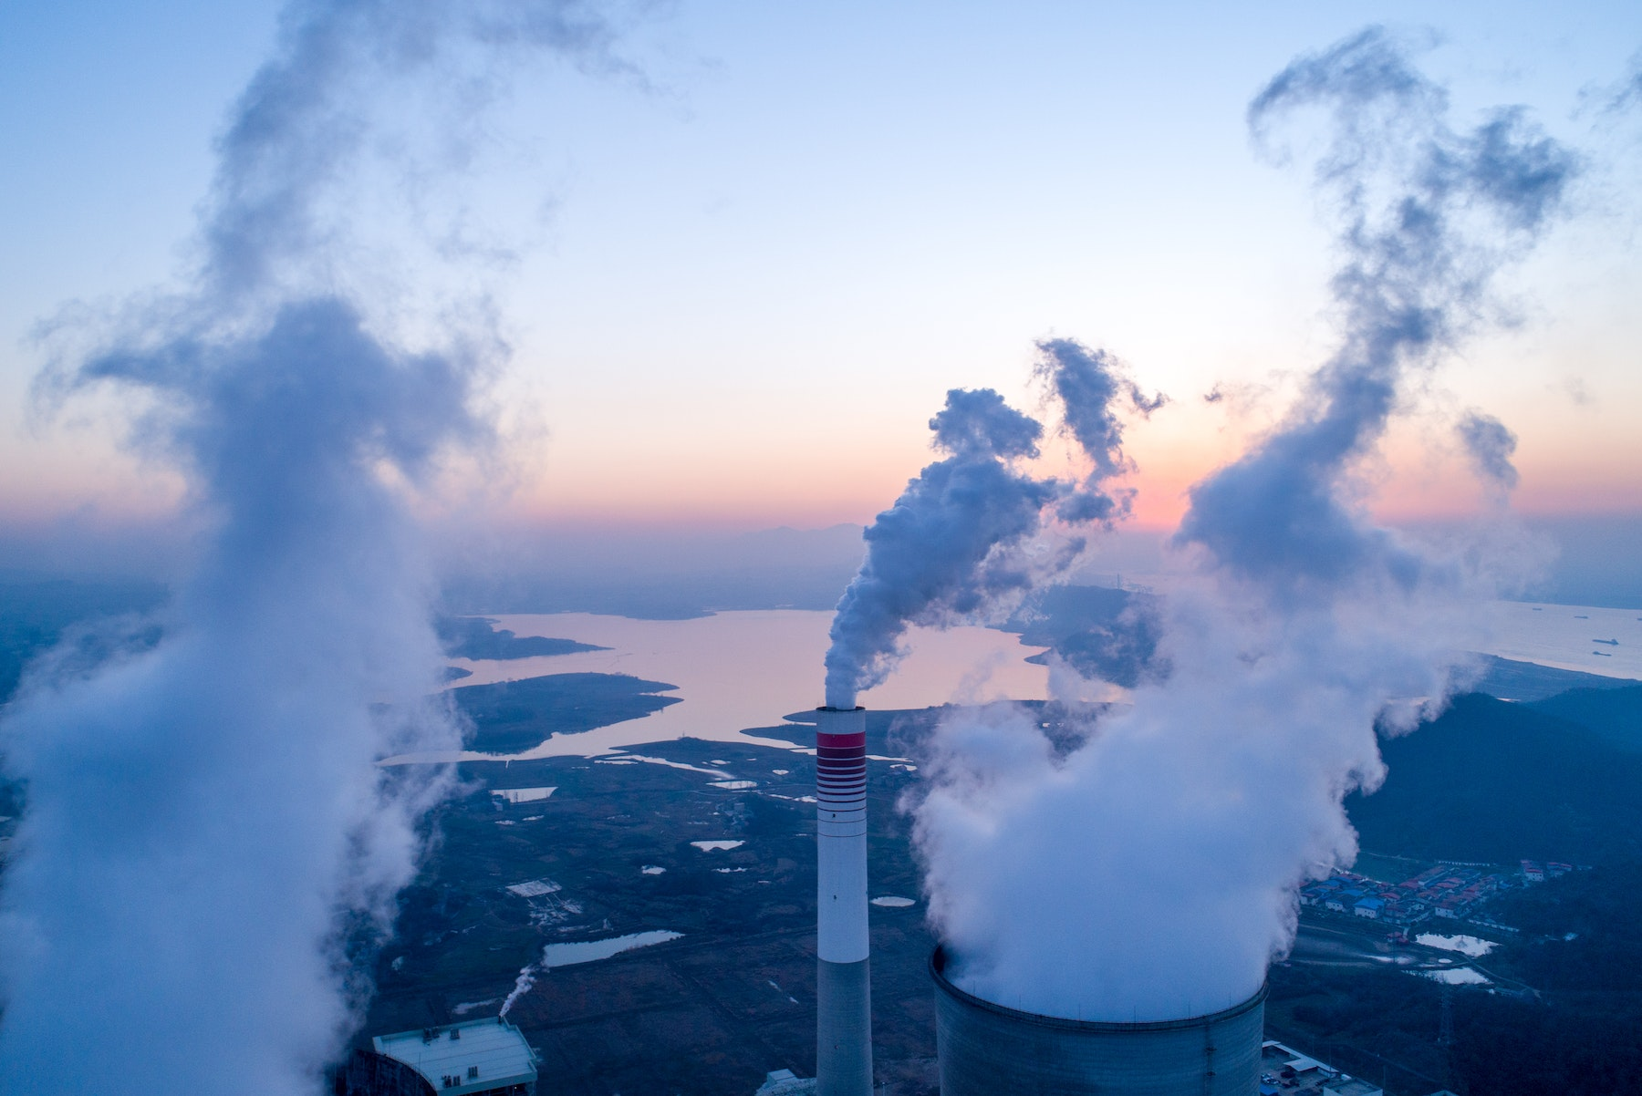

Main Cause of Global Warming and Climate Change
$$CO_{2} Emissions$$

Slide 13


Slide 14
Chapter 4:
Conclusion

Slide 15
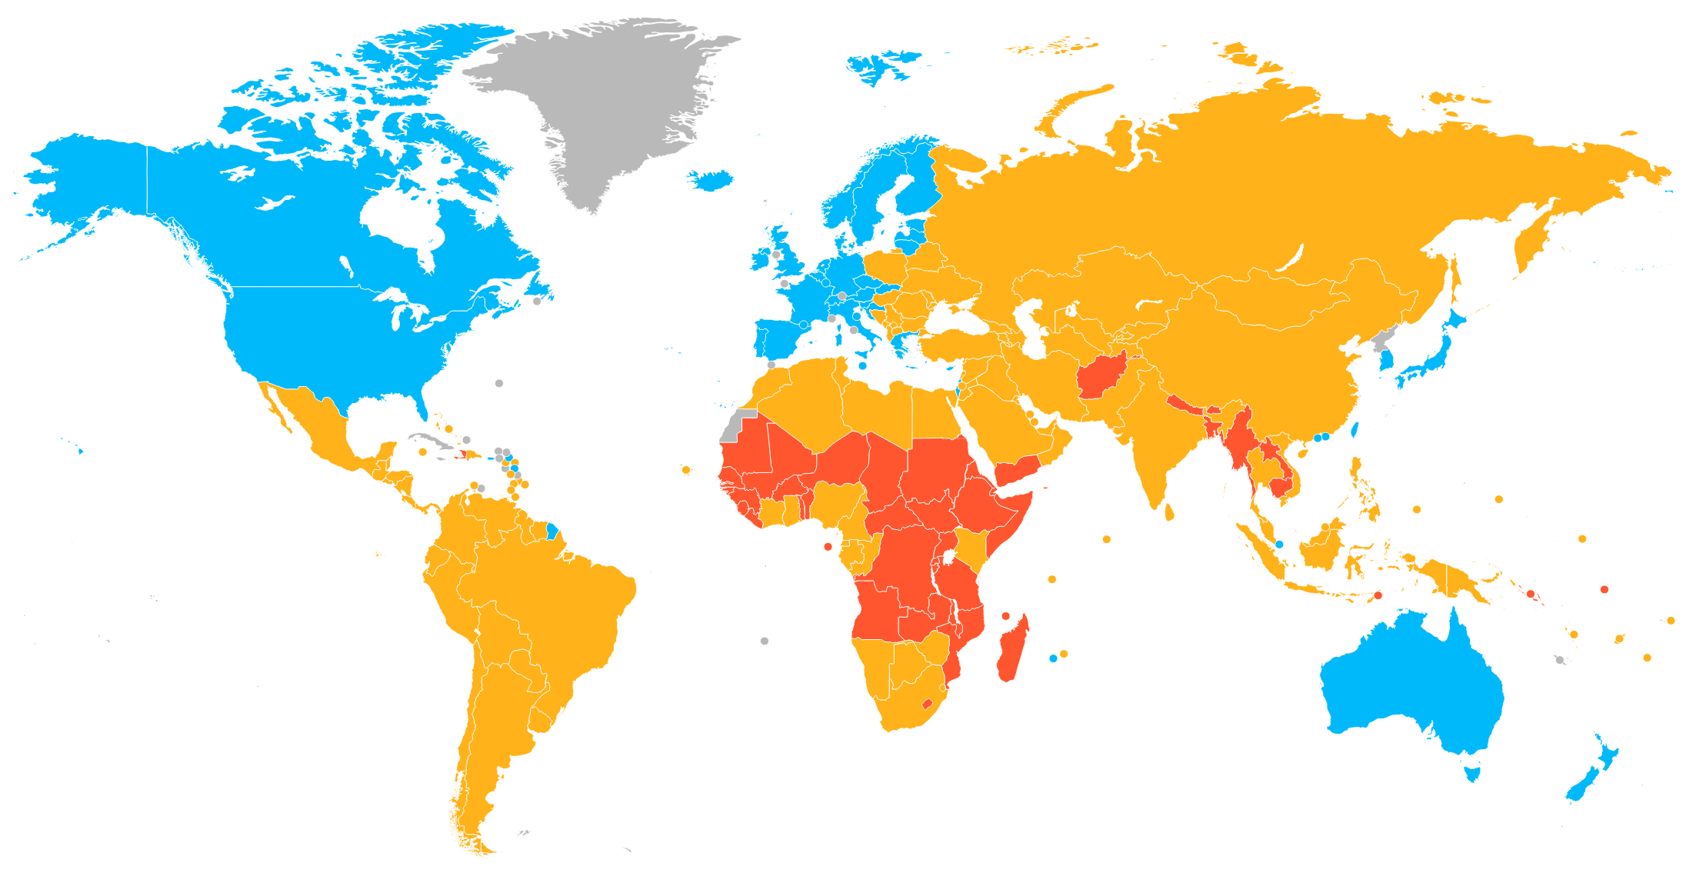

Developed Nations
Developing Nations
Catered the population better in history for long and hence need to cater now also in a better way
Started to develop their economies and needed to cater to the population in a better way:
Urbanization
Industrialization

Slide 16
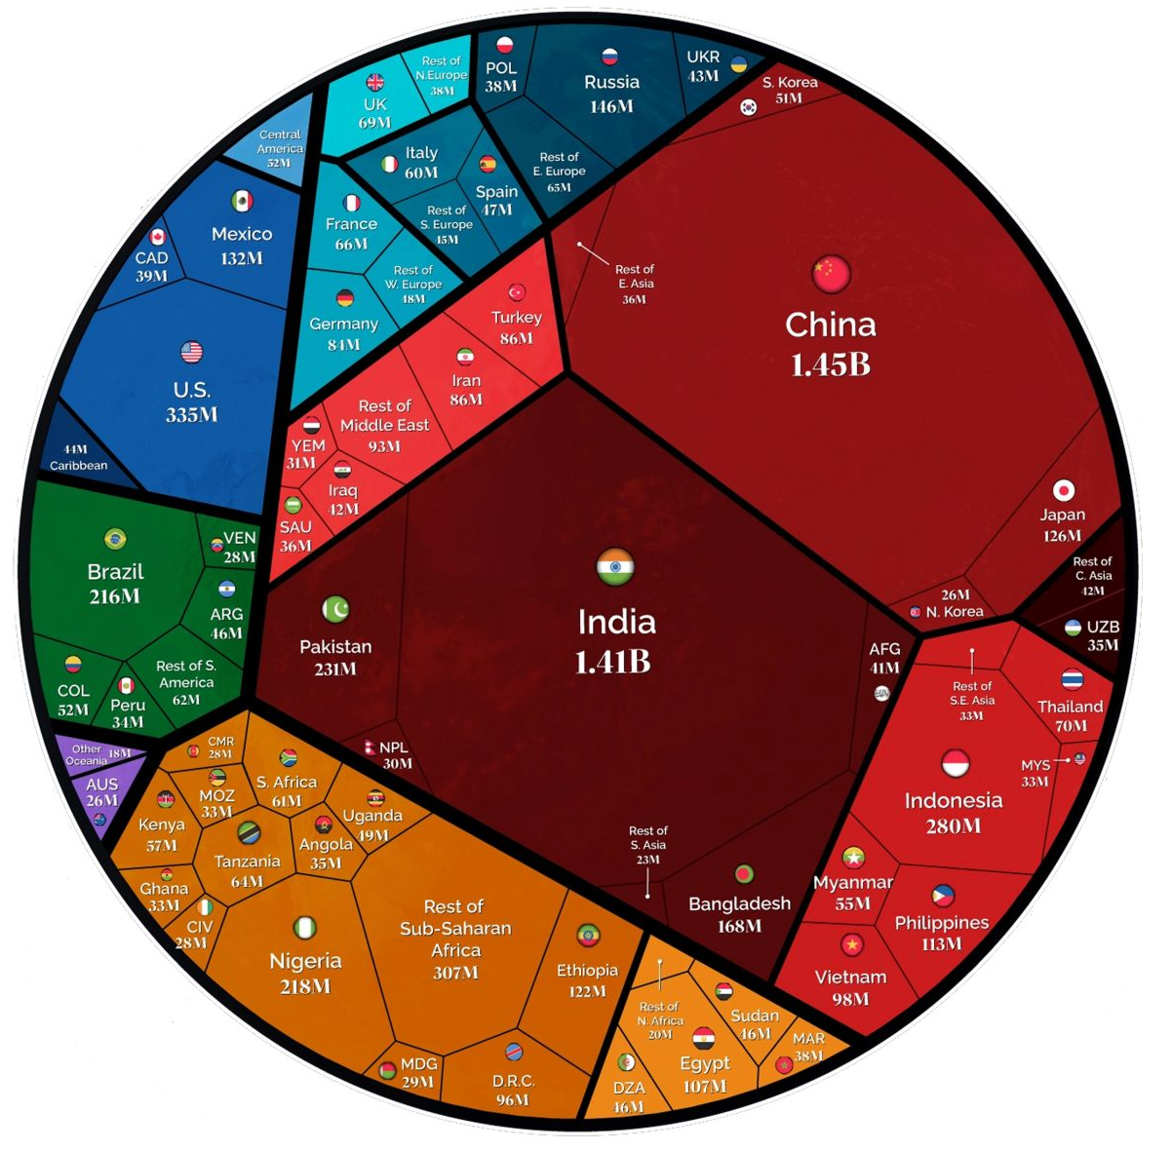
Solution
Three largest populous and CO2 emitters are:
US 🇺🇸
China 🇨🇳
India 🇮🇳
These countries should lead role in green energy and policy making. 🌱
References:https://www.linkedin.com/posts/somnath-ray_earthday-climateaction-usa-activity-7055641773997477888-UXsj?utm_source=share&utm_medium=member_android

Slide 17
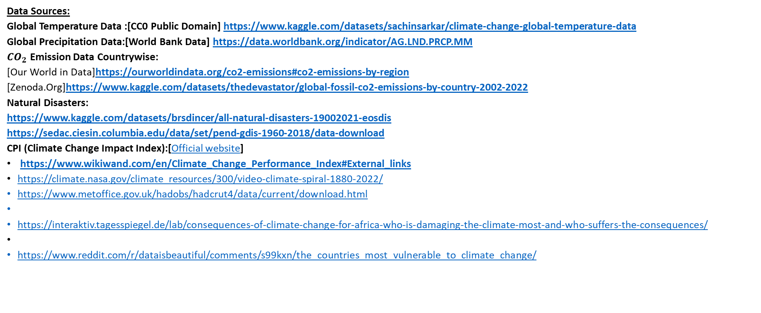
Thanks for your time ⏲️
Here are our Data References and Inspirations:
Data Sources:
Global Temperature Data :[CC0 Public Domain] https://www.kaggle.com/datasets/sachinsarkar/climate-change-global-temperature-data
Global Precipitation Data:[World Bank Data] https://data.worldbank.org/indicator/AG.LND.PRCP.MM
$CO_{2}$ Emission Data Countrywise:
[Our World in Data]https://ourworldindata.org/co2-emissions#co2-emissions-by-region
[Zenoda.Org]https://www.kaggle.com/datasets/thedevastator/global-fossil-co2-emissions-by-country-2002-2022
Natural Disasters:
https://www.kaggle.com/datasets/brsdincer/all-natural-disasters-19002021-eosdis
https://sedac.ciesin.columbia.edu/data/set/pend-gdis-1960-2018/data-download
CPI (Climate Change Impact Index):[Official website]
https://www.wikiwand.com/en/Climate_Change_Performance_Index#External_links
https://climate.nasa.gov/climate_resources/300/video-climate-spiral-1880-2022/
https://www.metoffice.gov.uk/hadobs/hadcrut4/data/current/download.html
https://interaktiv.tagesspiegel.de/lab/consequences-of-climate-change-for-africa-who-is-damaging-the-climate-most-and-who-suffers-the-consequences/
https://www.reddit.com/r/dataisbeautiful/comments/s99kxn/the_countries_most_vulnerable_to_climate_change/

